Slide 1
Chapter 7
Non-Requirements Metrics

Slide 2
Requirements engineering
Requirements engineering is the process of establishing
the services that the customer requires from a system (the constraints under which it operates and is developed
Requirements
The descriptions of the system services and constraints
that are generated during the requirements engineering process

Slide 3
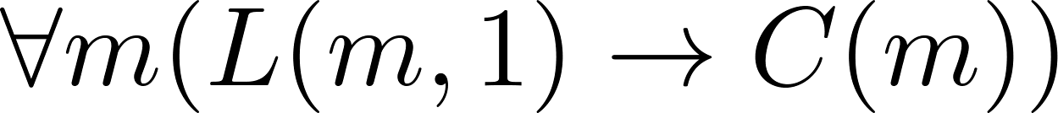
What is a requirement?
It may range from a high-level abstract statement of a service or of a system constraint to a detailed mathematical functional specification
  Every mail message larger than one megabyte will be compressed
    Let L(m, y) be “Mail message m is larger than y megabytes.”
    Let C (m) denote “Mail message m will be compressed.”
This is inevitable as requirements may serve a
  May be the basis for a bid for a contract - therefore must be open to interpretation
  May be the basis for the contract itself - therefore must be defined in detail
  Both these statements may be called requirements

Slide 4
Functional and non-functional requirements
Functional requirements
  Statements of services the system should provide
  how the system should react to particular inputs and how the system should behave in particular situations.
Non-functional requirements
  constraints on the services or functions offered by the system such as timing constraints, constraints on the development process, standards, etc.

Slide 5
Functional requirements
Describe functionality or system services.
Depend on the type of software, expected users and the type of system where the software is used.
Functional user requirements may be high-level statements of what the system should do but functional system requirements should describe the system services in detail.

Slide 6
The LIBSYS system
A library system that provides a single interface to a number of databases of articles in different libraries.
Users can search for, download and print these articles for personal study.

Slide 7
Examples of functional requirements
The user shall be able to search either all of the initial set of databases or select a subset from it.
The system shall provide appropriate viewers for the user to read documents in the document store.
Every order shall be allocated a unique identifier (ORDER_ID) which the user shall be able to copy to the account’s permanent storage area.

Slide 8
Non-functional Requirement (NFR)
specifies criteria that can be used to judge the operation of a system, rather than specific behaviors.
Describe properties of the system or the domain
the plan for implementing non-functional requirements is detailed in the system architecture, because they are usually architecturally significant
A system architecture
  is the conceptual model that defines the structure, behavior, and more views of a system

Slide 9
Classification of NFRs (1)
Product-oriented attributes
  Performance : (a) response time, (b) throughput (number of operations performed per second) (c) Latency (d) Load
  Usability: effort required to learn, use, provide input and interpret results of a program
  Efficiency: minimal use of resources (memory, processor, disk, network…)
  Reliability: of computations, precision
  Availability : Percentage of time that the system is up and running correctly
  Security
  Robustness: in the presence of faults, stress, invalid inputs…
  Adaptability: to other environments or problems
  Scalability: for large number of users or quantities of data
  Cost: total cost of ownership (TCO) for acquisition, installation, use

Slide 10
Classification of NFRs (2)
Product family-oriented attributes
  Portability: does it work for several platforms
  Modifiability: addition of new functionalities
  Reusability: of components, code, designs, and even requirements in other systems
  They are frequently demanded by developers to:
    Reduce development costs
    Increase revenues by creating several versions derived from a product

Slide 11
Classification of NFRs (3)
Process-oriented attributes
  Maintainability: changes to functionalities, repairs
  Readability: of code, documents
  Testability: ease of testing and error reporting
  Understandability: of design, architecture, code
  Integrability: ability to integrate components
  Complexity: degree of dependency and interaction between components

Slide 12
Quantification
Non-functional requirements need to be measurable
  Avoid subjective characterization: good, optimal, better...
Values are not just randomly specified
  Stakeholder must understand trade-offs
  Important to rank the requirements
Precise numbers are unlikely to be known at the beginning of the requirement process
  Ensure that quality attributes are identified
  Negotiate precise values later during the process

Slide 13
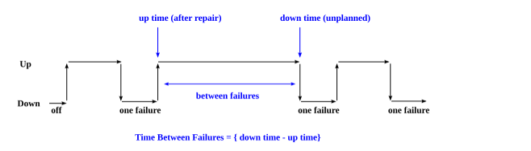
Measures vs. Metrics
We use measures in a generic way but there is actually a distinction between measures and metrics
For example, consider reliability
  Metric: mean time between failures
  Measure: number of failures in a period of time (an observation!)

Slide 14
Performance Measures (1)
Lots of measures
  Response Time:
    This is the amount of time taken by the application to respond to a request.
    You need to determine acceptable minimum, average, and maximum response times for your application under different loads Usually with probabilities, confidence interval
    Response time = time of response – time of request
    = 155494568775 – 1554945687257
    = 500 milliseconds
  Latency:
    A concept strongly linked to connection speed and bandwidth of a network
    This measures the delay to receive the first bit of the requested data.
    Lower latency ensures faster data delivery and better user experience
    describe the total time it takes for a data (information) packet to travel from a source node to a different destination node.
    Latency is generally measured in milliseconds (ms)

Slide 15
Performance Measures (2)
  Latency:
    Suppose Server A a data packet to Server B . Server A sends the packet at 04:38:00.000 and Server B receives it at 04:38:00.145 . The amount of latency on this path is the difference between these two times: 0.145 seconds or 145 milliseconds

Slide 16
Performance Measures (3)
Throughput:
  In software development refers to the amount of work completed in a given period of time.
  To measure Throughput, you need to track tasks completed over a specific period, such as a weeks , and calculate the average
  How to measure throughput?
    Step 1: Define the unit of work
      define what a unit of work in your development process. For example, you may decide that a unit of work is a fixed bug. It's important that the definition of a unit of work is consistent and clear for everyone on the team
    Step 2: Track progress
      track how many units of work are being completed in a given time period. For example, you might track the number of completed the number of fixed bugs over the course of a week.
    Step 3: Calculate the throughput
      Throughput = dividing the number of units of work completed by the amount of time it took to complete them. For example, if your team completed 20 user in a two-week , the throughput would be 20 user / 2 weeks. Important: You can’t measure a weekly throughput by dividing this number by 2.
      Suppose you have a development team of 5 people, and they completed a total of 20 user in 4 weeks. The team's throughput would be 20 user stories / 4 weeks.

Slide 17
Performance Measures (4)
  Throughput:
    This is the number of requests processed per unit time.
    maximum data in bits per second of a communications link or network access
    Defining the expected throughput helps in understanding the application’s capacity and determining whether the system can handle anticipated load
    The throughput is calculated by dividing the file size by the time to get the throughput in megabits, kilobits, or bits per second.
  Load:
    Define the maximum user load the application is expected to handle.
    It could be concurrent users, simultaneous requests, or data volume.
    Can be modeled and simulated (mainly at the architectural level) –
      Queuing model (LQN), Layered Queuing Network (LQN) Arrival rates

Slide 18
Performance Measures (2)
Examples of performance requirements
  The system shall be able to process 100 payment transactions per second in peak load.
  The website’s load time should not be more than one second for users
  In standard workload, the CPU usage shall be less than 50%, leaving 50% for background jobs.
  Production of a simple report shall take less than 20 seconds for 95% of the cases.
  Scrolling one page up or down in a 200 page document shall take at most 1 second.

Slide 19
Reliability Measures (1)
Software Reliability
  is the probability a component or system will perform as designed
  It is described as the ability of a system or component to perform its required functions under static conditions for a specific period.
  one and only the standard used to calculate the excellence of a software system
  Very important for critical, continuous, or scientific systems

Slide 20
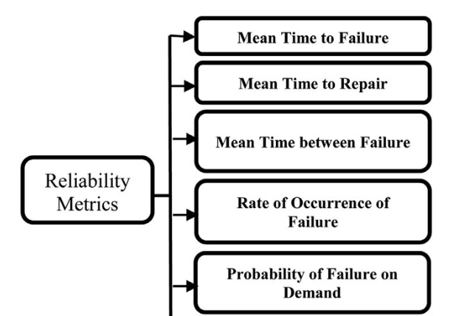
Reliability Measures (2)
Reliability Metrics

Slide 21
Reliability Measures (3)
1. Mean Time to Failure (MTTF)
  MTTF is described as the time interval between the two successive failures.
  An MTTF of 200 mean that one failure can be expected each 200-time units.
  The formula:
    MTTF = Total Operating Time / Number of Failures
  Imagine you’re calculating MTTF for three desktop hard drives. The first failure occurred after 62,000 hours. The second hard drive didn’t last as long, failing after 28,000 hours. Finally, the third hard drive failed after spending 42,000 hours in operation.
  MTTF = (62,000 + 28,000 + 42,000) / 3 units
  = 44,000 hours
  You can now reasonably assume that this particular make and model of hard drive will have a useful life of about 44,000 hours.

Slide 22
Reliability Measures (4)
Mean Time to Failure (MTTF)
  There are 125 identical printer, which operated a total of 60,000 hours in the last year. Your MTTF calculation would look like this:
  MTTF = Total hours of operation ÷ Total assets in use
  = 60,000 hours ÷ 125 assets
  = 480 hours
  When to use MTTF
    MTTF can be used to schedule maintenance.
    MTTF can also be used to make decisions about purchasing parts and equipment.

Slide 23
Reliability Measures (5)
Mean Time to Repair (MTTR)
  MTTR measures the average time it takes to track the errors causing the failure and to fix them.
  How is mean time to repair calculated?
    MTTR = Total time spent on repairs / Number of repairs
    Let's say a company's manufacturing line experienced mechanical failures that resulted in three hours of repair time before the issue was resolved. During the same month, there was a total of two repairs made to the equipment due to various issues.
    MTTR = 3 hours / 2 repairs
    = 1.5 hours

Slide 24
Reliability Measures (6)
Mean Time Between Failure (MTBF)
  We can merge MTTF & MTTR metrics to get the MTBF metric.
  MTBF = MTTF + MTTR
  Thus, an MTBF of 300 denoted that once the failure appears, the next failure is expected to appear only after 300 hours. In this method, the time measurements are real-time & not the execution time as in MTTF.
  How Do You Calculate MTBF?
    The MTBF is calculated by taking the total time a piece of software is running (i.e. uptime) and dividing it by the number of breakdowns that occurred over the same period.
    MTBF = Total uptime / # of breakdowns
    a software mixer designed to operate for 10 hours per day. Suppose the mixer breaks down after normally operating for 5 days. The MTBF for this case is 50 hours as calculated below.
    MTBF = (10 hours per day * 5 days) / 1 breakdown = 50 hours
    The MTBF calculation will require more steps when accounting for longer periods of time with increased occurrences of breakdowns.

Slide 25
Reliability Measures (7)
Mean Time Between Failure (MTBF)
  software observed to operate without issues for 1,000 hours. Throughout the period of 1,000 hours of normal operations, say that 4 occurrences of breakdowns were recorded. The following calculation shows that the MTBF for the software is 250 hours:
  MTBF = (1,000 hrs / 4 occurrences of breakdowns) = 250 hours when accounting for longer periods of time with increased occurrences of breakdowns.

Slide 26
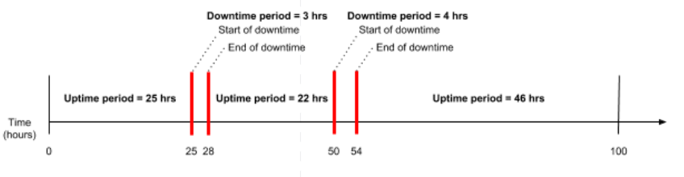
Reliability Measures (8)
Mean Time Between Failure (MTBF)
  software, running for 10 hours per day breaks down twice in the span of 10 days. The first breakdown occurred 25 hours from the start time and took 3 hours to repair. The second breakdown occurred 50 hours from the start time and took 4 hours to repair before the mixer was operating normally.
  the total uptime period is the sum of 25, 22, and 46 hours, and number of breakdowns (or the number of failures)
    MTBF = (25 hours + 22 hours + 46 hours) / 2 breakdowns = 93 hours / 2 breakdowns = 46.5 hours

Slide 27
Reliability Measures (8)
Rate of occurrence of failure (ROCOF)
  It is the number of failures appearing in a unit time interval.
  A ROCOF of 0.02 mean that two failures are likely to occur in each 100 operational time unit steps.
  It is also called the failure intensity metric.
  ROCOF also commonly refers to the failure rate.
  That is defined as the number of times that an asset breaks down during an observed period of time.
  The equation relating MTBF to ROCOF is: MTBF = 1 / ROCOF

Slide 28
Reliability Measures (9)
Probability of Failure on Demand (POFOD)
Reliability
  is the probability a component or system will perform as designed.
  Like all probability values, reliability is expressed a number ranging between 0 and 1, inclusive.
  Reliability value of zero (0) means the component or system is totally unreliable (i.e. it is guaranteed to fail).
  Reliability value of one (1) means the component or system is completely reliable (i.e. guaranteed to properly function).
  Dependability the probability that a system will function when called upon to act
  The unreliability of component or system is referred to as Probability of Failure on Demand (POFOD)
  POFOD is described as the probability that the system will fail when a service is requested.
  A POFOD of 0.1 means that one out of ten service requests may fail.
  POFOD is an essential measure for safety-critical systems.

Slide 29
Reliability Measures (10)
Probability of Failure on Demand (POFOD)
  Like dependability, this is also a probability value ranging from 0 to 1, inclusive.
  A POFOD value of zero (0) means there is no probability of failure (i.e. it is 100% dependable – guaranteed to properly perform when needed),
  while a POFOD value of one (1) means it is completely undependable (i.e. guaranteed to fail when activated).
  Dependability + POFOD = 1
  POFOD = 1 − Dependability
  Dependability = 1 − POFOD
  A system designed for high dependability should exhibit a small POFOD value (very nearly 0).

Slide 30
Reliability Measures (11)
Probability of Failure on Demand (POFOD)
  Suppose someone were to tell you the reliability of real time system (ICU) was 99.9 percent (0.999).
  The dependability of ICU is 0.999, then the POFOD is 0.001:
  POFOD = 1 − Dependability
  POFOD = 1 − 0.999
  POFOD = 0.001
  Let’s suppose an ICU manufacturer a goal of only 1 failed in any of hospital during a 1 million unit production run, assuming four ICU per hospital, this equates to a 1/4000000 POFOD. The necessary dependability of this manufacturer’s ICU must therefore be:
  Dependability = 1 − POFOD = 1 − (1/4000000) = 0.99999975
  POFOD = 1 - 0.99999975 = 0.00000025

Slide 31
Availability Measures (1)
Availability is the probability that a system or component is operational and available at a given time
Availability is often calculated using the formula:
Availability = (MTBF / (MTBF + MTTR)), where MTTR is the mean time to repair.
For example, let’s say you’re trying to calculate the availability of a ATM. That ATM ran for 200 hours in a single month. That ATM also had two hours of downtime because of a breakdown, and eight hours of downtime for weekly Mantinuns . That equals 10 hours of total downtime.
Availability = 200 ÷ (200 + 10)
Availability = 200 ÷ 210
Availability = 0.952
Availability = 95.2%

Slide 32
Availability Measures (2)
Examples
  The system shall meet or exceed 99.99% uptime.
  The system shall not be unavailable more than 1 hour per 1000 hours of operation.
  Less than 20 seconds shall be needed to restart the system after a failure 95% of the time. (This is a MTTR requirement)
Availability Downtime
  90% 36.5 days/year
  99% 3.65 days/year
  99.9% 8.76 hours/year
  99.99% 52 minutes/year
  99.999% 5 minutes/year
  99.9999% 31 seconds/year

Slide 33
Usability Measures (1)
A product can be used by specified users to achieve specified goals with effectiveness, efficiency, and satisfaction in a specified context of use.
Usability also refers to methods for improving ease-of-use during the design process.
Usability can be further subdivided into three qualities:
  Effectiveness:
    How easy is it for users to accomplish a given task?
    These metrics determine whether or not users can complete tasks and goals.
  Efficiency:
    How quickly can users accomplish these tasks?
    These metrics determine the cognitive resources it takes for a user to complete tasks and goals.
  Satisfaction:
    How happy are users with their experience accomplishing these tasks?

Slide 34
Usability Measures (2)
How to measure usability
1- Completion Rates
  Completion rates, also called success rates, are the most fundamental of usability metrics .
  They are typically collected as a binary measure of task success (coded as 1) or task failure (coded as 0).
  Completion rate = (Number of successful users / Total number of users) x 100
  For example, if 8 out of 10 users complete a task successfully, the completion rate is 0.8 and usually reported as 80%. You can also subtract the completion rate from 100% and report a failure rate of 20%.

Slide 35
Usability Measures (3)
How to measure usability
2. Number of errors
  Number of errors is an effectiveness metric that tabulates the number of errors a user makes while performing the given tasks.
  These errors are different from bugs or software errors, but rather are human errors made in the process of completing the task.
  “Mistakes” are errors that result from a misunderstanding of the interface or poor decision-making, and should be minimized by the design.
  The number of errors can be calculated by tabulating all of the errors a user makes while completing a given task. The lower this number is, the better.

Slide 36
Usability Measures (4)
How to measure usability
3. Task time
  Is an efficiency metric that measures the time taken by users to complete a specific task.
  A shorter task time often indicates a more efficient design. It can be tabulated using the following formula:
  Task time = End time - Start time
  If a user starts a task five minutes into a test and completes the task 10 minutes into the task, that task time is five minutes.

Slide 37
Usability Measures (5)
How to measure usability
4. Learnability
  After a given training time
  An efficiency metric that assesses how quickly users can perform a task accurately after they've had prior experience with the product.
  It's measured by comparing task times across different iterations or repetitions.
  for example, a complex task may take 30 minutes on a user’s first time, but with repetition, they may get that down to 10 minutes. This can be showing the task time going down with each repetition.

Slide 38
Usability Measures (6)
How to measure usability
5. Time on page
An efficiency metric that calculates the total time users spend on a specific screen or page during their interaction with the product.
It’s calculated using the same formula as time on task: simply measure the amount of time the user is on that screen. You can also subtract their start time (on that page) from the completion time (of looking at that page).

Slide 39
Maintainability Measures (1)
Software maintainability
  the degree to which a software system can be maintained in a timely and effective manner.
  There are many factors that contribute to software maintainability
    code quality,
    documentation,
    architecture,
    test coverage.
  Types of Software Maintenance
    perfective maintenance,
      which is performed in order to improve the quality of the software system , (New User Requirements)
    adaptive maintenance
      performed in order to keep the software system up-to-date with changes in the environment, such as changes in operating systems or hardware..

Slide 40
Maintainability Measures (2)
Software Maintainability Metrics
  Cyclomatic Complexity:
    Is a measure of the number of independent paths through a program's source code.
    A high cyclomatic complexity indicates a complex program that is difficult to understand and maintain.
  Maintainability Index:
    Is a measure of how easy it is to maintain a software system.
    The index is calculated using a formula that takes into account various factors, such as code complexity and the number of bugs
  Code Coverage:
    Is a measure of how much of the code is executed when the tests are run.
    A high code coverage indicates that most of the code is being tested and that there are few areas of the code that are not covered by tests.
  Changeability:
    Is a measure of how easy it is to make changes to the code.
    A high changeability indicates that the code is easy to modify and that few changes will break the system.

Slide 41
Maintainability Measures (3)
Cyclomatic Complexity
  Is a metric that measures the complexity of a program by counting its decision points
  Is the quantitative measure of the number of linearly independent paths.
  It is computed using the control flow graph of the program.
  The nodes in the graph indicate the smallest group of commands of a program, and a directed edge in it connects the two nodes
  For example,
    if the source code contains no control flow statement then its cyclomatic complexity will be 1, and the source code contains a single path in it.
    if the source code contains one if condition then cyclomatic complexity will be 2 because there will be two paths one for true and the other for false.
    Formula for Calculating
      M = E – N + 2P
      where
      E = the number of edges in the control flow graph
      N = the number of nodes in the control flow graph
      P = the number of connected components

Slide 42
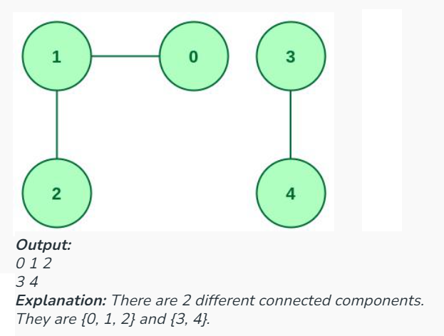
Maintainability Measures (4)
Cyclomatic Complexity
  Connected components- vertices in the set S should reach one another via a path.

Slide 43
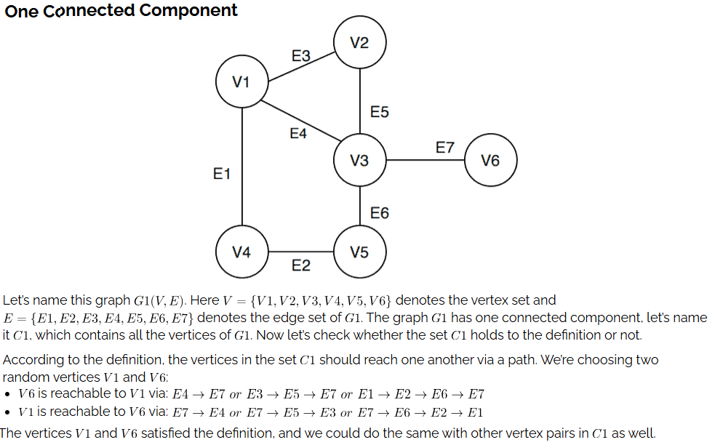
Maintainability Measures (5)

Slide 44
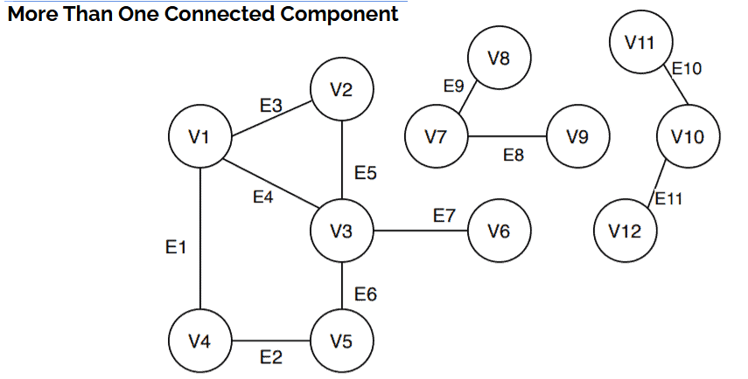
Maintainability Measures (5)

Slide 45
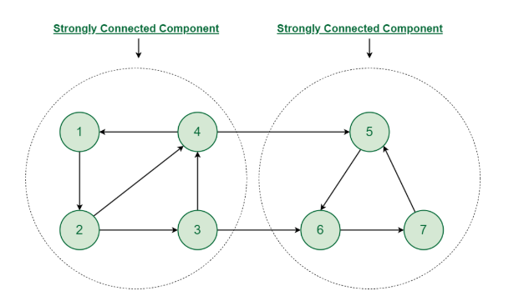
Maintainability Measures (6)
Strongly Connected Components
  means that for any two nodes A and B in this subgraph, there is a path from A to B and a path from B to A.

Slide 46
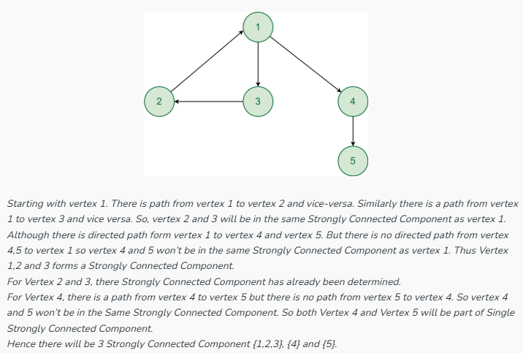
Maintainability Measures (7)
Strongly Connected Components

Slide 47
Maintainability Measures (8)
Cyclomatic Complexity
    Formula for Calculating
      M = E – N + 2P
      where
      E = the number of edges in the control flow graph
      N = the number of nodes in the control flow graph
      P = the number of connected components
    In strongly connected, and cyclometric complexity is defined as
      M = E – N + P
    In the case of a single method, P is equal to 1. So, for a single subroutine, the formula can be defined as
      M = E – N + 2

Slide 48
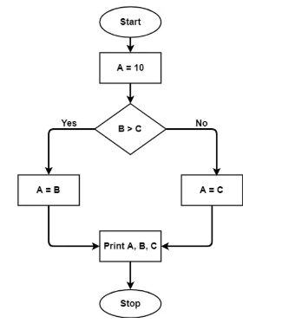
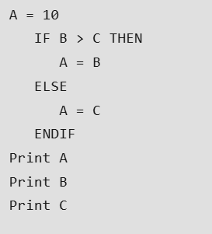
Maintainability Measures (9)
Cyclomatic Complexity

Slide 49
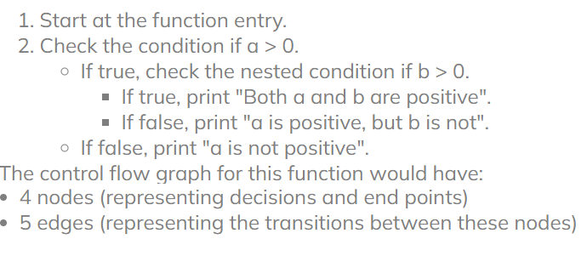
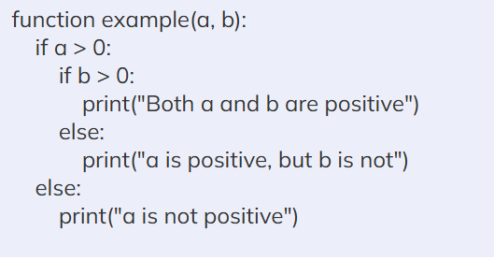
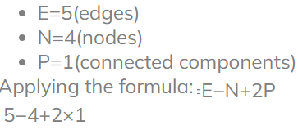
Maintainability Measures (10)
Cyclomatic Complexity

Slide 50
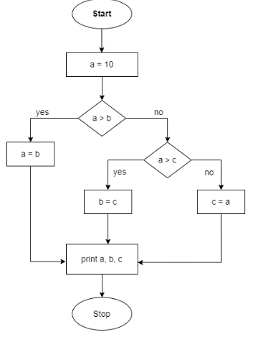
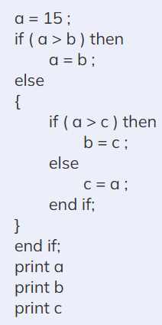

Maintainability Measures (11)
Cyclomatic Complexity

Slide 51
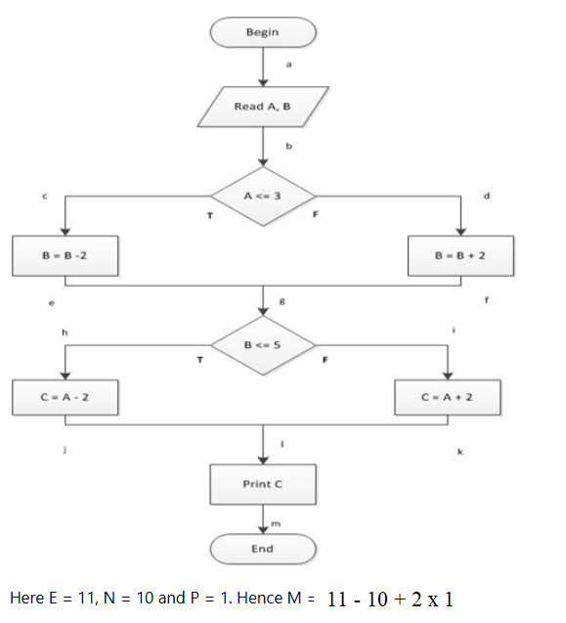
Maintainability Measures (12)
Cyclomatic Complexity

Slide 52
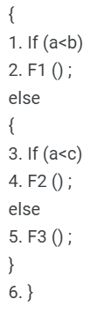
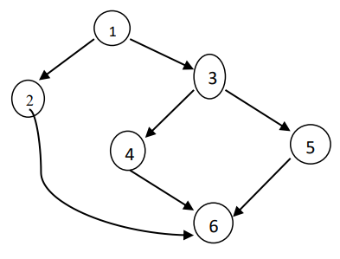

Maintainability Measures (13)

Slide 53
Maintainability Measures (3)
Examples of requirements
  No method in any object may exceed 200 lines of code.
  Installation of a new version shall leave all database contents and all personal settings unchanged.
  The product shall provide facilities for tracing any database field to places where it is used.

Slide 54
Testability Measures
Measures the ability to detect, isolate, and fix defects….. (…
  Time to run tests
  Time to setup testing environment (development and execution) (
  Probability of visible failure in presence of a defect (
  Test coverage (requirements coverage, code coverage…)
Examples
  test data.
    If you are going to test your system properly, you need suitable test data.
    You might just use a copy of your real customer data.
    However, this has problems.
      If your system handles sensitive data (banking data), you can’t just allow anyone to have access to this data.
      if you have a new system you may not have any test data yet

Slide 55
Portability Measures
Measure ability of the system to run under different computing environments
  Hardware, software, OS, languages, versions, combination of these
  the process of testing how easily software or a product can be transferred from one environment to another
  It measures the level of effort needed to move it from one system to another.
Can be measured as
  Number of targeted platforms (hardware, OS…)
  Proportion of platform specific components or functionality
  Mean time to port to a different platform
Examples
  Software designed to run on Macintosh OS and Microsoft Windows operating systems
  Software that should be compatible with Google Chrome and Mozilla Firefox browsers
  No more than 5% of the system implementation shall be specific to the operating system.
  The meantime needed to replace the current Relational Database System with another Relational Database System shall not exceed 2 hours. No data loss should ensue.

Slide 56
Integrability and Reusability Measures
Integrability
  Measures ability to make separated components work together
  Can be expressed as
    Mean time to integrate with a new interfacing system
Reusability
  Measures ability that existing components can be reused in new applications
  Can be expressed as
    Percentage of reused requirements, design elements, code, tests…
    Coupling of components
    Degree of use of frameworks

Slide 57
Robustness Measures
Measure ability to cope with the unexpected
  The robustness of a software application is the measure of the ability of a software application to deal with invalid or erroneous input effectively
  Percentage of failures on invalid inputs
  Degree of service degradation
    Minimum performance under extreme loads
    Active services in presence of faults
    Length of time for which system is required to manage stress conditions
Examples
  The estimated loss of data in case of a disk crash shall be less than 0.01%.
  The system shall be able to handle up to 10000 concurrent users when satisfying all their requirements and up to 25000 concurrent users with browsing capabilities.

Slide 58
Domain-specific Measures
The most appropriate quality measures may vary from one application domain to another, e.g.:
Performance
  Web-based system:
  Number of requests processed per second
  Video games:
  Number of 3D images per second
Accessibility
  Web-based system:
  Compliance with standards for the blind (
  Video games:
  Compliance with age/content ratings systems (e.g., no violence)

Slide 59
End of Presentation

